Slide 1
Welcome!
Yuval
Piotr
Benedikt
Jiri
Francesca
Michal
Fernando
Elisabeth
Big Data Biogeography
Physalia Courses, Berlin
4th – 8th November 2019
Manuel
Iván
Flavio
Konstantinos
Glenda
Gabriele
Sophie
Ivana

Slide 2
Schedule for the week
Monday : Big data in biogeography
Tuesday: Biogeography through space
Wednesday: Historical biogeography
Thursday: Fossil biogeography
Friday: Big data in biogeography

Slide 3
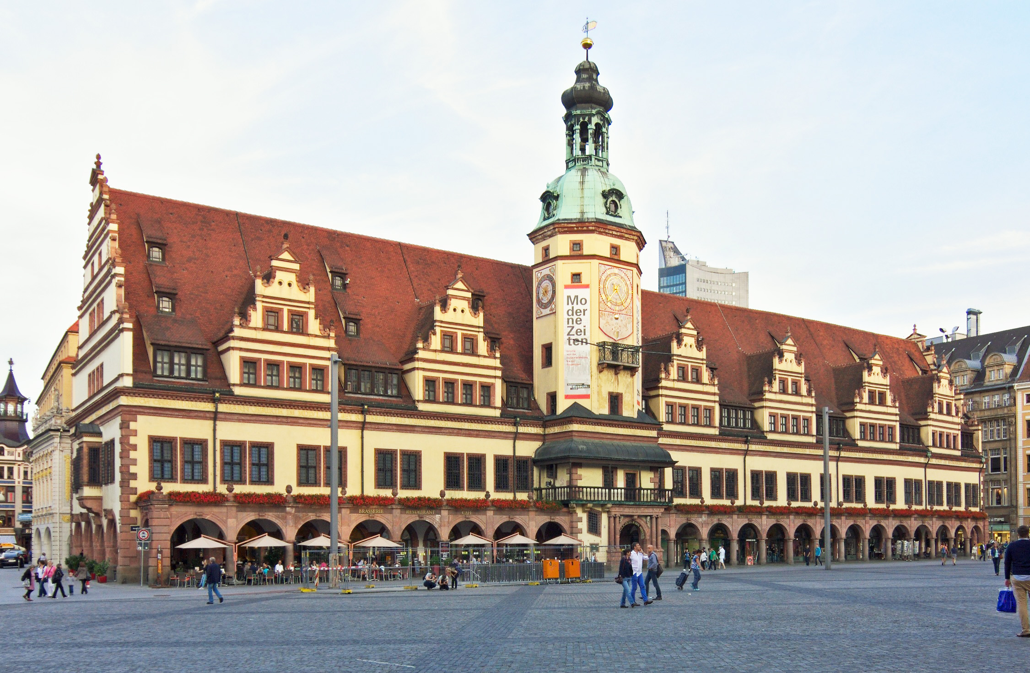




This is us

Slide 4
Course Philosophy
Hands on!

Slide 5
The course page
https://idiv-biodiversity.github.io/2019_big_data_biogeography/

Slide 6
Course project
Run exercises with your own group of interest/data
You’ll have time to focus on exercises that interest you most
Short presentation of the results on Friday

Slide 7
Today’s Schedule
Morning
1. Hi from Alex & Daniele
2. Presentations of course participants
3. Lectures setting the scene “Big data and biogeography”
Afternoon
4. Literature discussion
5. Lecture and hands on biodiversity databases
6. Design of the course projects

Slide 8
Before we start…
Form pairs, stand up and complete the following sentences (4 min each):
I really love these socks, because……
If I were to be born as another animal, I would have chosen to be a ………, because ………..

Slide 9
Present yourself
Where are you from?
What is your research about?
What is your level in R?
What kind of data did you bring (if you brought some)?
What do you expect from this course?

